Slide 1
Mini project 1-b -: topic :- space invaders (Python game)
Team Members:
VU1F1920097 MISHRA TUSHAR
VU1F1920102 SONI JASWANT
VU1F1920104 DUBEY AYUSH
VU1F1920112 ADDAGATLA NITESH
Vu1f1920122 Singh Disha
SE COMPS
Div.: B / Batch: B
Instructor: Prof. Asha Rawat

Slide 2
Outline
Introduction
Problem Statement
Goals & Objective
Methodology
Flow Chart
Software & Hardware Requirements
Results
Conclusion
Future Scope
References

Slide 3
introduction
Space Invaders game is completely made up of Python Programming language.
We chose Python because it is a high level programming language and it is the most versatile among other programming languages.
It easy to code as well as it requires less instructions.
Also, in future if there is a need to upgrade, modify or debugging it can be easily done without any problem

Slide 4
Problem Statement
To make simple, interesting and less storage consumed game using Python programming (py game).
To make a game such that it has less complicated controls and its very easy to play.
To make a game which does not requires any personal data, Login systems.
To make a game which is ready to play just with few clicks.

Slide 5
Goals & Objective
The main objective of this project was to entirely design and develop a Game using Python Programming in Pygame library, entitled Simple Space, while at the same time learning different disciplines and tools needed for game development.
In order to be able to achieve this main objective, We have split the project into a set of different targets from which the specific tasks were later created.
These general targets include: • Creating a player controlled character and giving it the ability to shoot enemies inside the game level.
Making playable level with different enemies.
Notes:
Add animation transition start after previous

Slide 6
Goal & objective
And give enemies the ability to shoot back at the player or do some other kind of damage.
Making different sound effects to be heard when the user is shooting or doing some other things.
Creating sound effects such as explosions, background music, shooting sounds

Slide 7
Methodology
Code for Spaceship
Spaceship
Design in
CorelDraw
Code for
Bullets
Bullet design in CorelDraw
Code for
Enemies
Finding
Errors
Final Project
Code Completed
Code for
Level, Lives & Health bar
Enemies design in CorelDraw
Notes:
Add animation transition start after previous

Slide 8
Flow Chart
SPACE INVADERS GAME
SHIP CLASS
OBSTACLE
MAIN():
FOR PLAYING
DRAW()
GAMELOOP
PLAYER
ENEMY
MOVE()
HEALTH=100
PLAYER()
MOVE()
COLLISION ()
DRAW()
ENEMY()
MOVER_LASER()
SHOOT()
COLLIDE()
Enemy collide with player
COOLDOWN()
SHOOT():
SPACEBAR
SHOOT():
HEALTHBAR()
MOVE()

Slide 9
Software & Hardware Requirements
Software
Hardware
Windows Pentium or above
Mac OS
Linux OS
Windows i3 10th gen
CorelDraw
PyCharm
Mouse
Keyboard
2GB RAM or above
Computer
Mouse
Keyboard
Software and hardware used

Slide 10
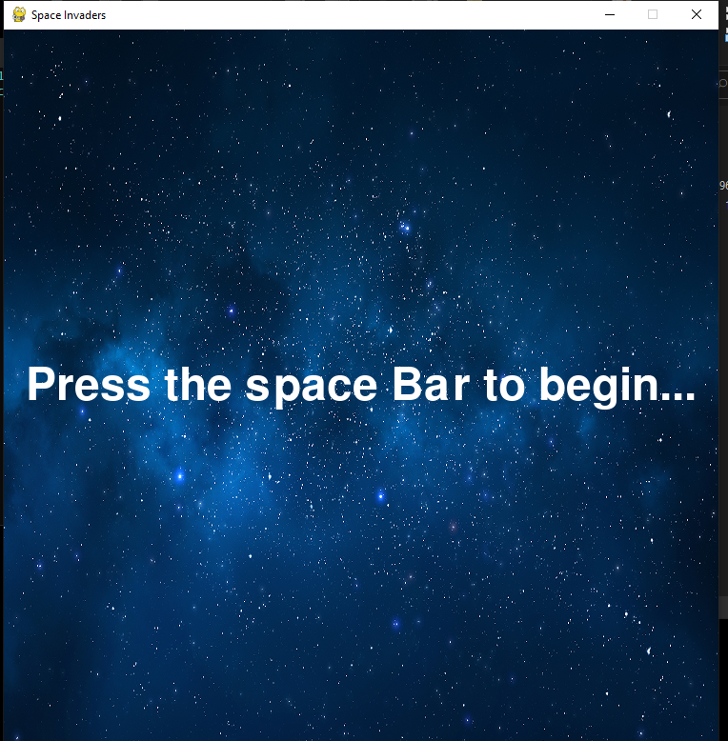
Results
Beginning of the game

Slide 11
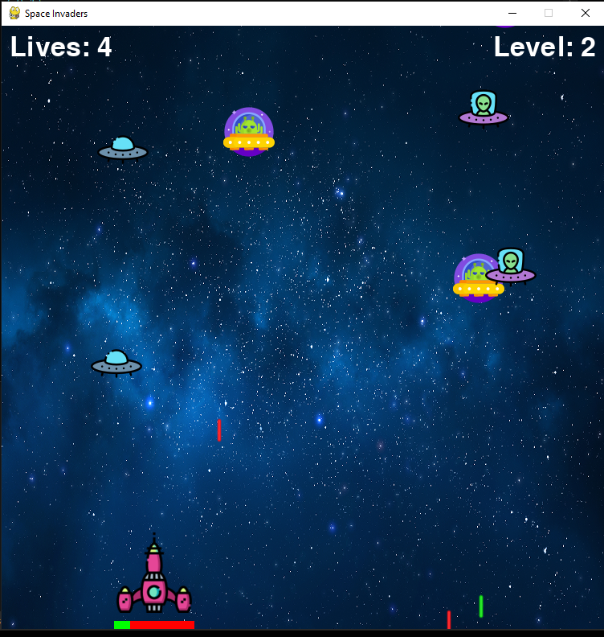
Results:-
Overall view of the Game
Controls:-
Spacebar to fire laser beam
Arrow keys to move the space ship

Slide 12
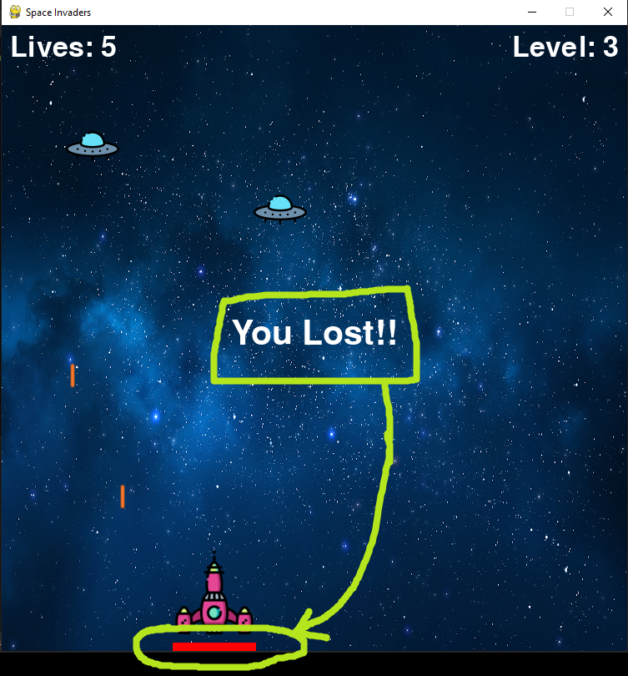
Results
Here, we lost because we completely used our health bar

Slide 13
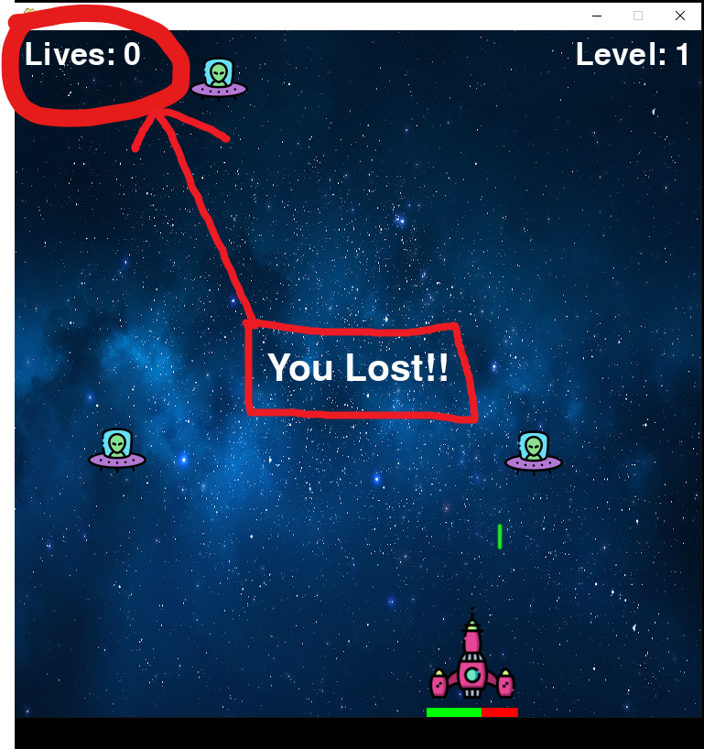
Results
Here, we lost because our life chances were completely used

Slide 14
Conclusion
Hence, we made simple, interesting and less storage consumed game using Python programming (py game).
Also, a game such that it has less complicated controls and its very easy to play.
Also, a game which does not requires any personal data, Login systems.
Also, a game which is ready to play just with few clicks.

Slide 15
Future Scope
Create a complete projectile system with many types of projectiles and ways to shoot them, using different approaches.
Create more levels with different game-play options, each of them with new enemies and bosses.
Create a power-up system that allows players to get new powers, such as super-speed, score multiplier, damage multiplier
Make a different kind of reward logic, like including a multiplier to calculate the final score.
Make different types of ships that can be used as the Player.

Slide 16
References
Github.com
Udemy
w3schools.com/python
Python.org
YouTube

Slide 17
Thankyou

